Slide 1
Determining a strategy for introduction of a chain of Restaurants

Slide 2
Restaurant chains can be risky
Restaurant chains is one of the most popular business model in recent times, but opening a restaurants in a wrong location can leave one in loss rather than profit.
Therefore in order to reduce the risk involved, one can use the below described method to determine the locations where the restaurants can be opened to minimize risk in Mumbai.

Slide 3
Data acquisition and cleaning
The list of name of all the neighbourhoods in Mumbai along with their area has been taken from the Wikipedia page ‘https://en.wikipedia.org/wiki/List_of_neighbourhoods_in_Mumbai’
After getting the address of each neighbourhoods, geolocator is used to get the latitude and longitude of all the neighbourhoods. The neighbourhoods without any result from the geolocator are removed.

Slide 4
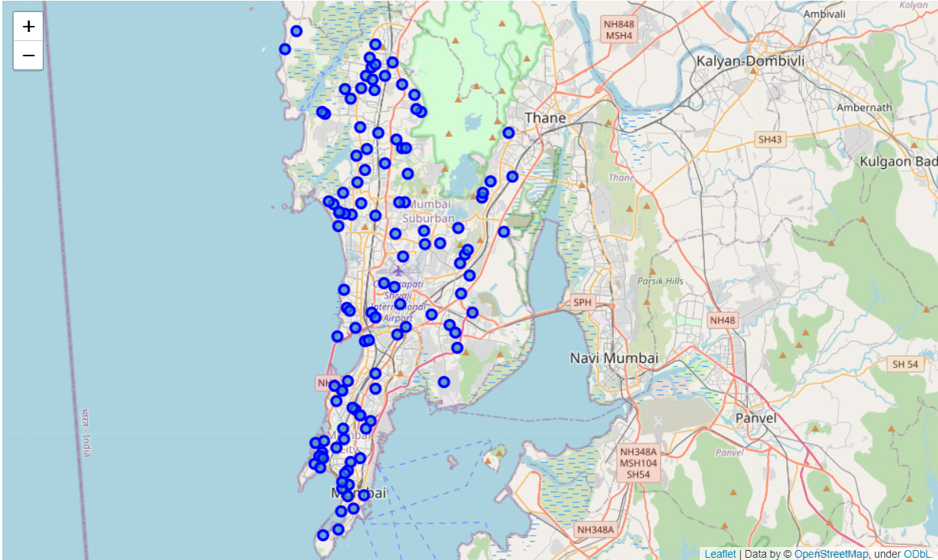
Map Representing all the neighbourhood in Mumbai according to our data set

Slide 5
Analysis and Clustering
Foursquare api’s explore function was called to find the venues in each neighbourhoods in a radius of 500 m
After getting the venues another dataframe is created in which the frequencies of each category of venues is stored
Finally top 10 venue categories with their frequencies is extracted and the k means clustering with k = 4 was used to cluster the neighbourhoods was done.

Slide 6
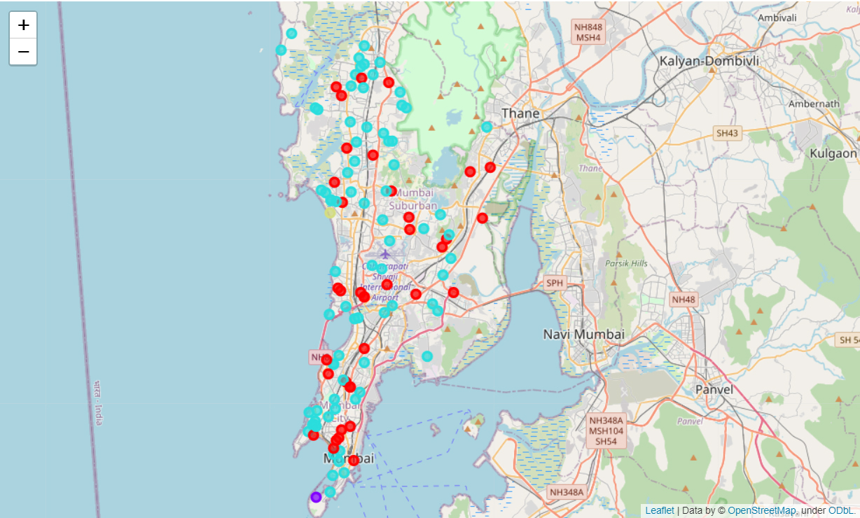
Map plotting different cluster of neighbourhoods in Mumbai

Slide 7
Observation and Conclusion
Neighbourhoods in cluster 1 and 2 seems to be residential and food trucks can be used for testing before opening a poper restaurant or pop up shops.
Neighbourhoods in cluster 3 i.e. Arey Milk colony can benifit from a food truck
Neighbourhoods in cluster 4 appear to be a mix of buisness and residential are, hence restaurants can be setup in these areas

